Slide 1
Lecture 1: Intro to Unsupervised Learning for BIG DATA
CPSC/AMTH 453/553
CBB 555

Slide 2
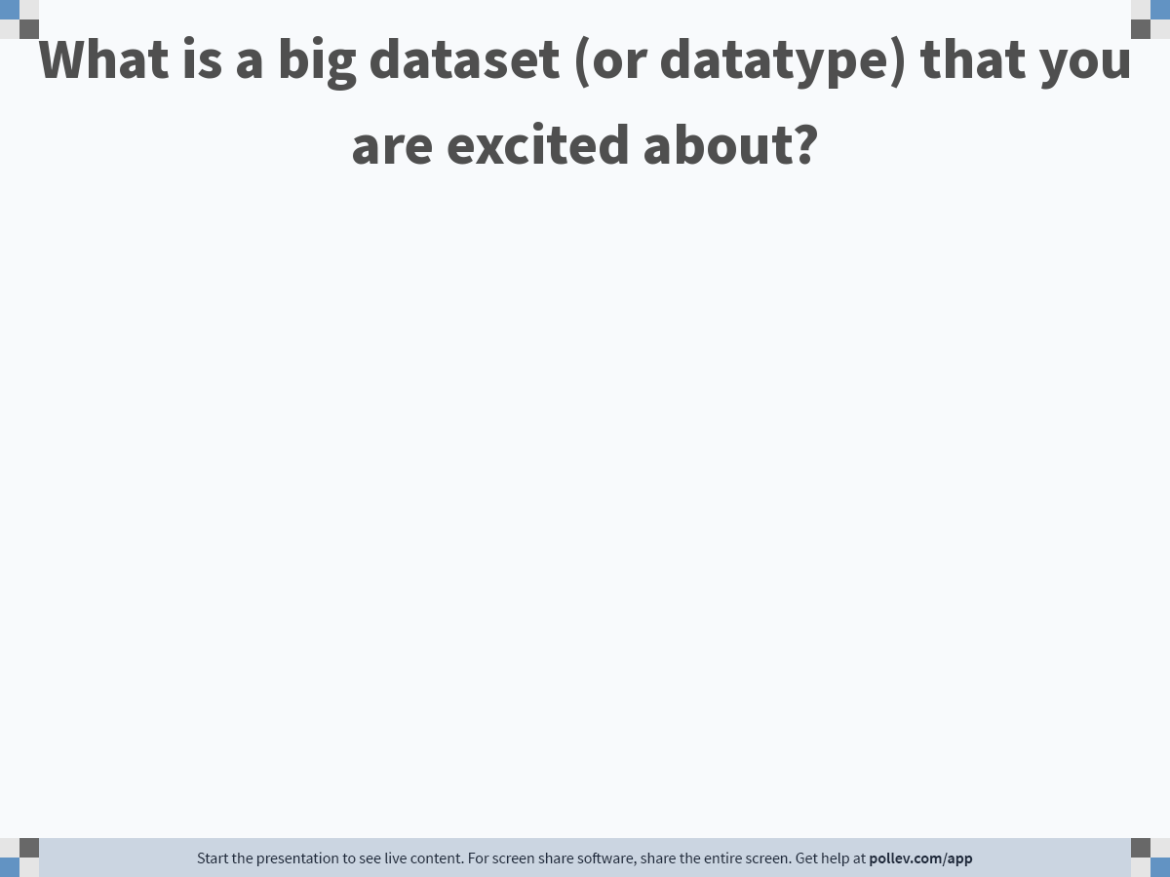
Notes:
Do not modify the notes in this section to avoid tampering with the Poll Everywhere activity. More info at polleverywhere.com/support What is a big dataset (or datatype) that you are excited about?
https://www.polleverywhere.com/free_text_polls/rmrpaNYHJVKq3Ln1ipv1M

Slide 3
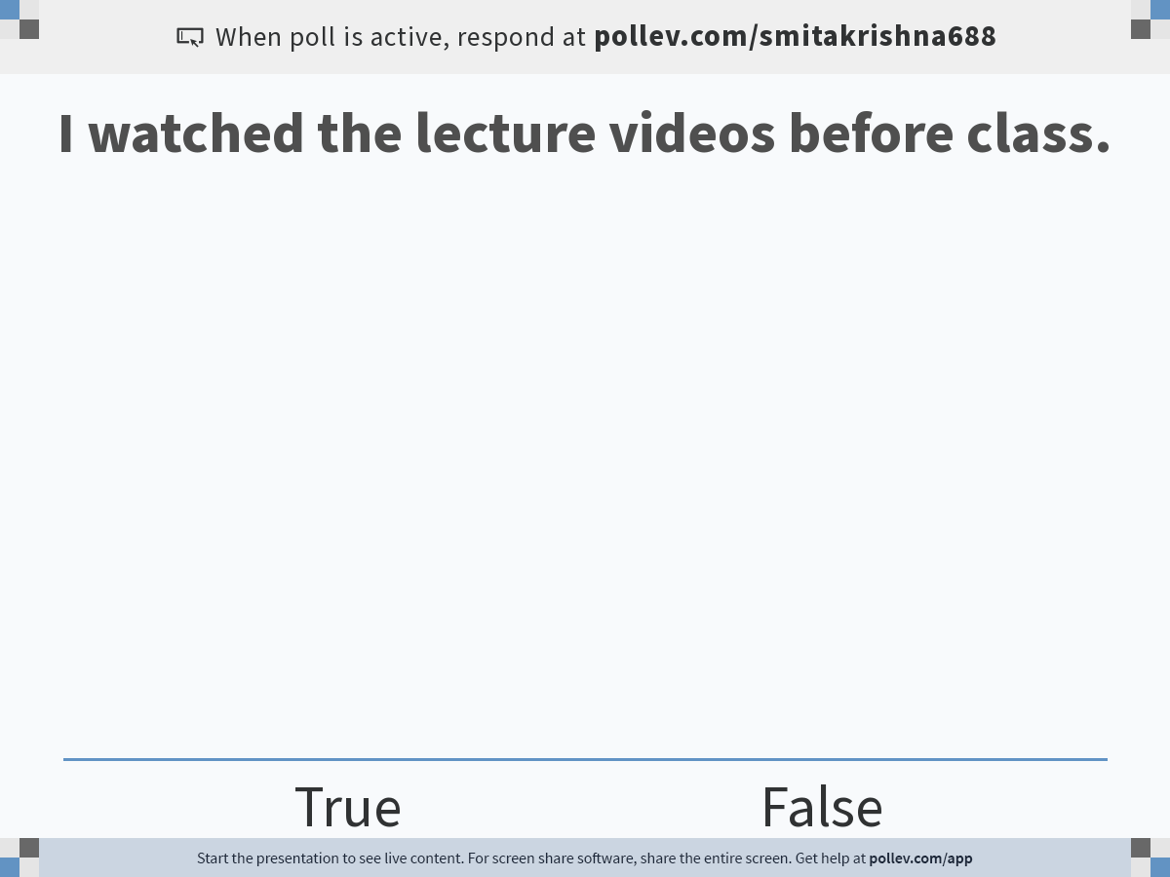
Notes:
Do not modify the notes in this section to avoid tampering with the Poll Everywhere activity. More info at polleverywhere.com/support I watched the lecture videos before class.
https://www.polleverywhere.com/multiple_choice_polls/LQS6xC1DVQMmoMkSD3hFk?flow=Default&onscreen=persist

Slide 4
Course Logistics
This class is cross-listed with Computer Science, Applied Math, Computational Biology Bioinformatics,
Instructor: Prof. Smita Krishnaswamy, smita.krishnaswamy@yale.edu
Instructor office hours: After class on Tuesdays at AKW 104, or on zoom by appointment
TA: Sasha Safonova (sasha.safonova@yale.edu)
ULAs: Michal Gerasimiuk (michal.gerasimiuk@yale.edu), Yasin Tarabar (yasin.tarabar@yale.edu)
TA: Discussion Section
TA: Office hours
No specific book (I am writing one), but various reference materials

Slide 5
What will I learn in this course?
How to explore big, high dimensional, noisy data without labels !
Data Geometry
Dimensionality reduction and representation learning (PCA, diffusion maps)
Visualization (tSNE/UMAP, PHATE)
Clustering (K-Means, Community Detection)
Graph signal processing (Denoising, Scattering Transforms)
Probability distribution-based analysis (information theory, generative modeling, optimal transport)
(Unsupervised) Deep Learning: Autoencoders, GANs
Maybe topology

Slide 6
What will be the format of the course?
Pre-recorded lecture content on the technical material
Activities to deepen understand in class
Examples that we will work through
Derivations that we will write out
Extensions of the material
Recent papers related to the material
Hands-on coding
It will help to bring your laptop to class
We will have polls using poll.ev
Coding examples will use google colab notebooks

Slide 7
Prerequisites?
How much CS do I have to know?
Must be comfortable programming in python
Algorithms knowledge helps
How much math do I have to know?
Linear algebra: matrix multiplication, change of bases, eigenvectors, eigenvalues, adjacency matrices
How much stats do I have to know?
Not much!
We will cover covariance, probability distributions

Slide 8
What will my grade be based on?
3 homeworks – 30%
Homework 1 assigned around September 10 (Due October 5): Dimensionality reduction
Homework 2 assigned around October 5 (Due November 2): Clustering and graph signal processing
Homework 3 assigned around November 9 (Due December 6): Neural networks, autoencoders, generative models
Final Project (BYOD) – 30%
Final Exam – 25%
Canvas quizzes 15% (Roughly quizzes worth 3 points each)

Slide 9
What is machine learning?
Machine learning is the process of identifying patterns in data.

Slide 10

Two kinds of machine learning
Supervised learning
Have a bunch of labelled data, want to label new data

Slide 11


Two kinds of machine learning
Supervised learning
Have a bunch of labelled data, want to label new data
Supervised Learning Model
Noun project

Slide 12
Two kinds of machine learning
Supervised learning
Have a bunch of labelled data, want to label new data
Supervised Learning Model
Strawberry!
Noun project

Slide 13
Two kinds of machine learning
Supervised learning
Have a bunch of labelled data, want to label new data
Supervised Learning Model
Noun project

Slide 14
Two kinds of machine learning
Supervised learning
Have a bunch of labelled data, want to label new data
Supervised Learning Model
Banana
Noun project

Slide 15
Two kinds of machine learning
Supervised learning
Have a bunch of labelled data, want to label new data
Supervised Learning Model
Noun project

Slide 16
Two kinds of machine learning
Supervised learning
Have a bunch of labelled data, want to label new data
Supervised Learning Model
Strawberry!
Noun project

Slide 17
Two kinds of machine learning
Supervised learning
Have a bunch of labelled data, want to label new data
Supervised Learning Model
Noun project

Slide 18
Two kinds of machine learning
Supervised learning
Have a bunch of labelled data, want to label new data
Supervised Learning Model
?
Noun project

Slide 19
Two kinds of machine learning
Supervised learning
Have a bunch of labelled data, want to label new data
Supervised Learning Model
Strawberry!
Noun project

Slide 20





Two kinds of machine learning
Supervised learning
Have a bunch of labelled data, want to label new data
Unsupervised learning
Have a bunch of unlabeled data, want to organize it
Supervised Learning Model
Unsupervised Learning Model
Strawberry
Noun project
Notes:
Differentiate between supervised and unsupervised learning, left figure should have the label strawberry as output, right figure should also just have one image but it should have maybe a couple of vectors (of numbers) as output

Slide 21
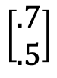
Two kinds of machine learning
Supervised learning
Have a bunch of labelled data, want to label new data
Unsupervised learning
Have a bunch of unlabeled data, want to organize it
Supervised Learning Model
Unsupervised Learning Model
Strawberry
$$\left[\begin{matrix}.7 \\ .5\end{matrix}\right]$$
Noun project
Notes:
Differentiate between supervised and unsupervised learning, left figure should have the label strawberry as output, right figure should also just have one image but it should have maybe a couple of vectors (of numbers) as output

Slide 22
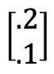
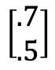
Two kinds of machine learning
Supervised learning
Have a bunch of labelled data, want to label new data
Unsupervised learning
Have a bunch of unlabeled data, want to organize it
Supervised Learning Model
Unsupervised Learning Model
Strawberry
$$\left[\begin{aligned}.2 \\ .1\end{aligned}\right]$$
$$\left[\begin{aligned}.7 \\ .5\end{aligned}\right]$$
Noun project
Notes:
Differentiate between supervised and unsupervised learning, left figure should have the label strawberry as output, right figure should also just have one image but it should have maybe a couple of vectors (of numbers) as output

Slide 23
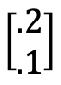
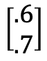
Two kinds of machine learning
Supervised learning
Have a bunch of labelled data, want to label new data
Unsupervised learning
Have a bunch of unlabeled data, want to organize it
Supervised Learning Model
Unsupervised Learning Model
$$\left[\begin{aligned}.2 \\ .1\end{aligned}\right]$$
Strawberry
$$\left[\begin{aligned}.6 \\ .7\end{aligned}\right]$$
$$\left[\begin{aligned}.7 \\ .5\end{aligned}\right]$$
Noun project
Notes:
Differentiate between supervised and unsupervised learning, left figure should have the label strawberry as output, right figure should also just have one image but it should have maybe a couple of vectors (of numbers) as output

Slide 24
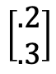
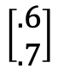
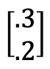
Two kinds of machine learning
Supervised learning
Have a bunch of labelled data, want to label new data
Unsupervised learning
Have a bunch of unlabeled data, want to organize it
Supervised Learning Model
Unsupervised Learning Model
$$\left[\begin{aligned}.3 \\ .2\end{aligned}\right]$$
$$\left[\begin{aligned}.2 \\ .1\end{aligned}\right]$$
$$\left[\begin{aligned}.2 \\ .3\end{aligned}\right]$$
Strawberry
$$\left[\begin{aligned}.7 \\ .5\end{aligned}\right]$$
$$\left[\begin{aligned}.6 \\ .7\end{aligned}\right]$$
Noun project
Notes:
Differentiate between supervised and unsupervised learning, left figure should have the label strawberry as output, right figure should also just have one image but it should have maybe a couple of vectors (of numbers) as output

Slide 25
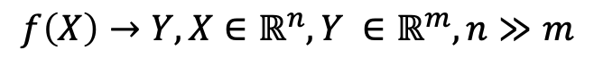
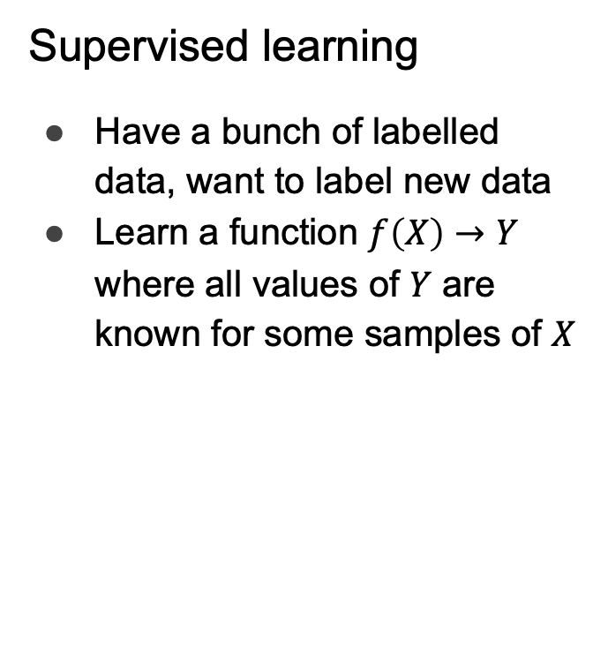
Two kinds of machine learning
Supervised learning
Have a bunch of labelled data, want to label new data
Learn a function $f\left(X\right)→Y$ where all values of $Y$ are known for some samples of $X$
Unsupervised learning
Have a bunch of unlabeled data, want to organize it
Learn an embedding
Lower dimensional, easier to interpret (e.g. as clusters)
$$f\left(X\right)→Y, X∈ℝ^{n},Y ∈ℝ^{m}, n≫m$$
Supervised Learning Model
Unsupervised Learning Model
Noun project
Notes:
Carry the change to the figures

Slide 26
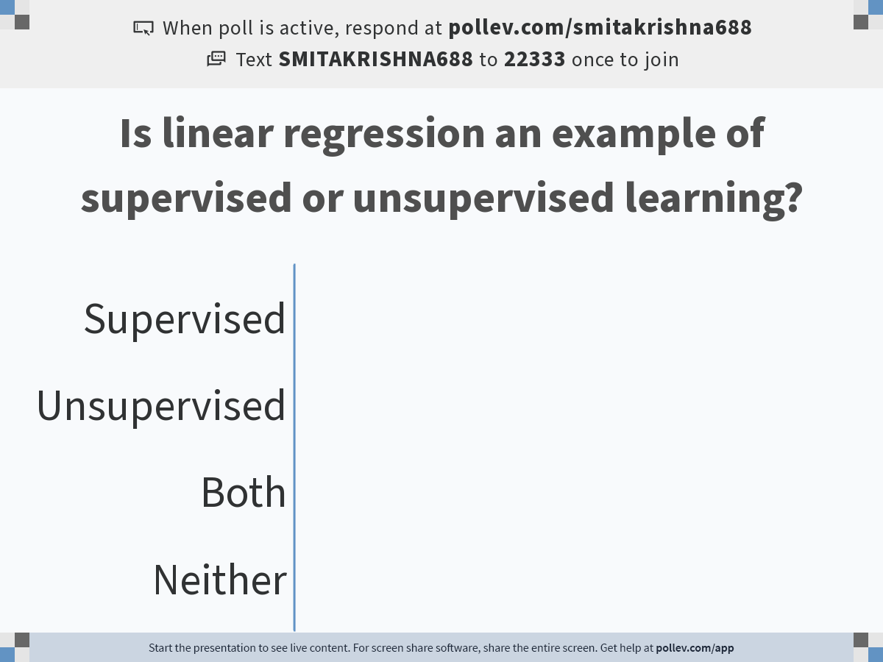
Notes:
Do not modify the notes in this section to avoid tampering with the Poll Everywhere activity. More info at polleverywhere.com/support Is linear regression an example of supervised or unsupervised learning?
https://www.polleverywhere.com/multiple_choice_polls/89HA3nApobBtNmHo1hf9D?flow=Default&onscreen=persist

Slide 27
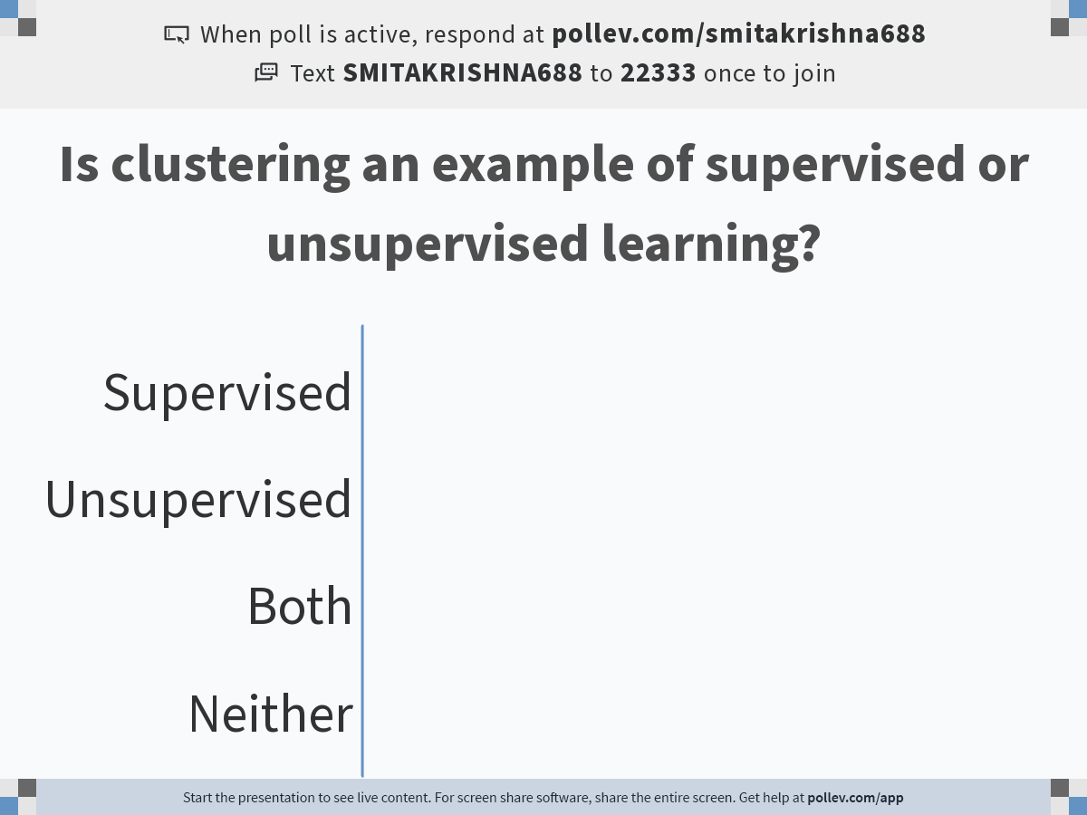
Notes:
Do not modify the notes in this section to avoid tampering with the Poll Everywhere activity. More info at polleverywhere.com/support Is clustering an example of supervised or unsupervised learning?
https://www.polleverywhere.com/multiple_choice_polls/iBS8sAdJmTEU3dY9WFc80?flow=Default&onscreen=persist

Slide 28

Why Python?

Slide 29
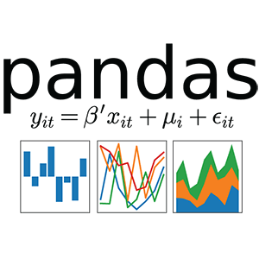

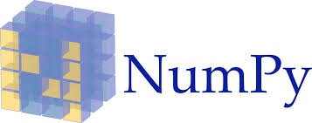




Why Python?
Tensorflow
Pytorch

Slide 30


Slide 31

Final Project: Bring-your-own-data
Noun project

Slide 32
Intro to Big Data
Noun project

Slide 33


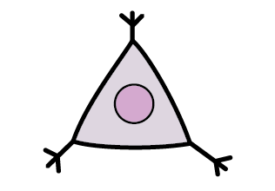
What is data?
Observations are vector of features/attributes/measurements of an entity
e.g. Cell A = [40 0 20 18 5 0 …]
The whole data is a matrix with many observations
Features
(e.g. genes)
 | X | Y | Z
A | 10 | 20 | 70
B | 20 | 40 | 140
C | 20 | 0 | 80
Observations
(e.g. cells)

Slide 34
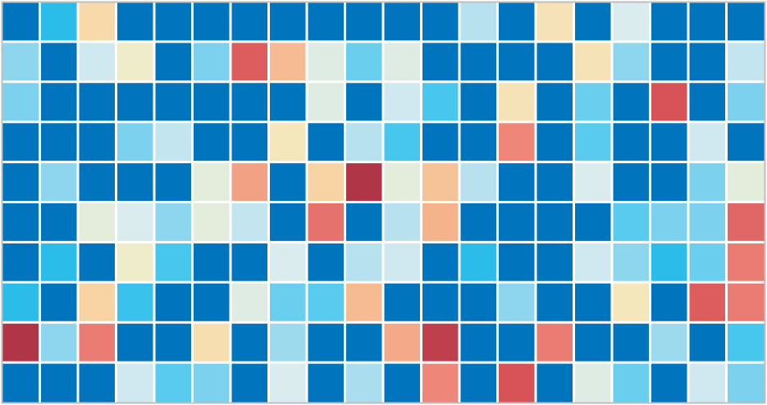
Multiple Datasets form a Tensor
Samples
(1-10)
Cells
(1K – 10M)
Genes / Proteins
(10-10K)

Slide 35
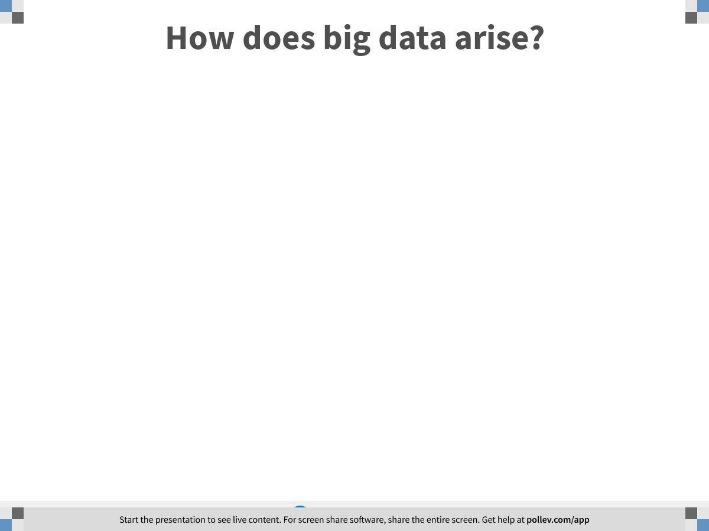
Notes:
How does big data arise?
https://www.polleverywhere.com/free_text_polls/9LmXXTntVNM0xA0stTNg4

Slide 36
Biomedical Examples
I usually use biomedical examples because:
I specialize in applying Big data to Biomedical Examples
Biomedical entities like cells, people, proteins are super complex, the amount of measurements we have does not give a complete picture
Techniques like this applied to simpler data
There are LOTS of people generating high dimensional, high throughput, biomedical data at Yale—so you can start exciting collaborations immediately

Slide 37

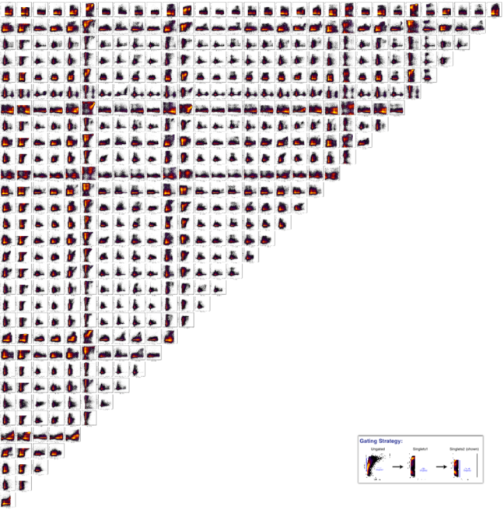

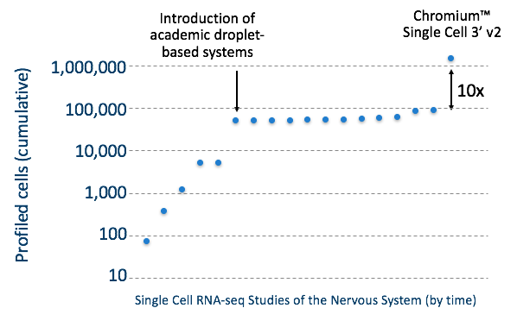

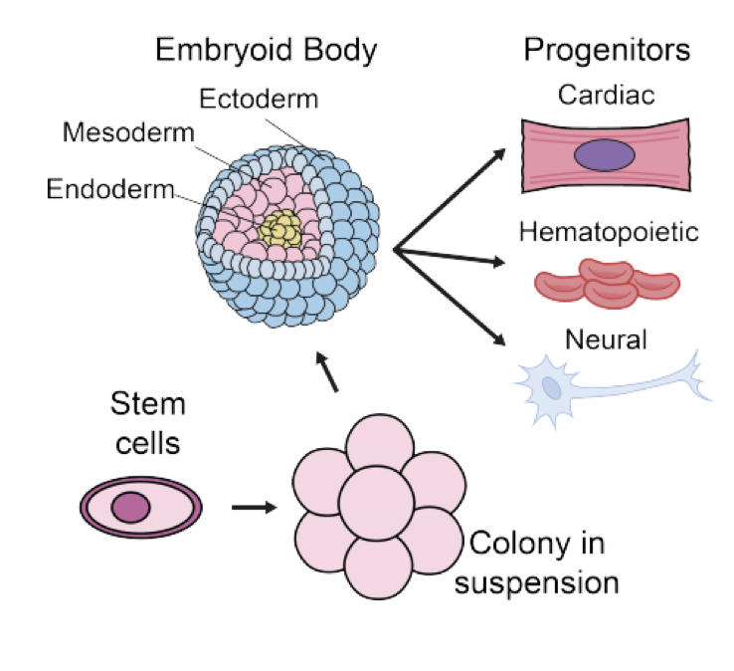
High Dimensional
High Throughput
Heterogeneous
Notes:
Features of this data is that its high dimensional ---gives us a view of the whole system, high throughput – measurements for thousands even hundreds of thousands of cells in each condition. And single cell resolution.

Slide 38








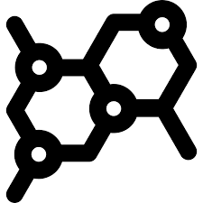
Many dimensions = many measurements
Diagnoses
labs
drug response
assays
ECG
Gene 1
Gene 2
Gene 3
Proteins

Slide 39
High Throughput = Many observations

Slide 40
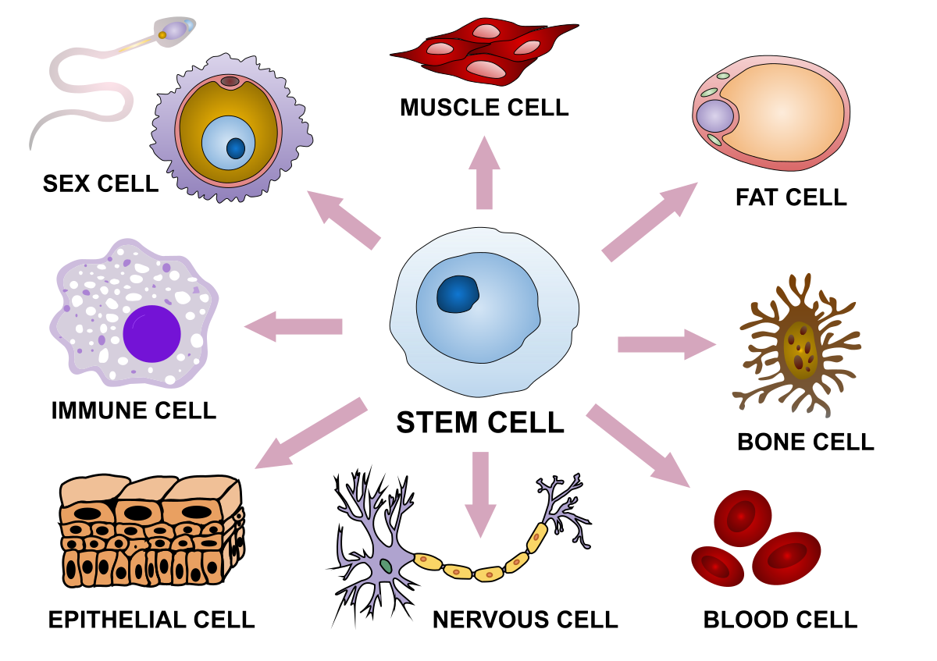
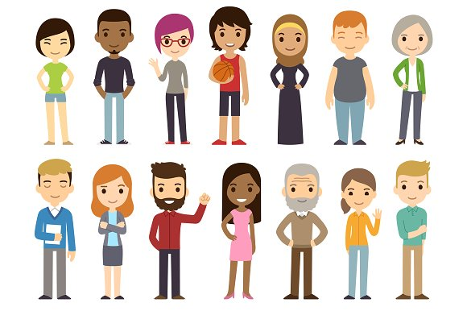
Heterogeneous Observations

Slide 41
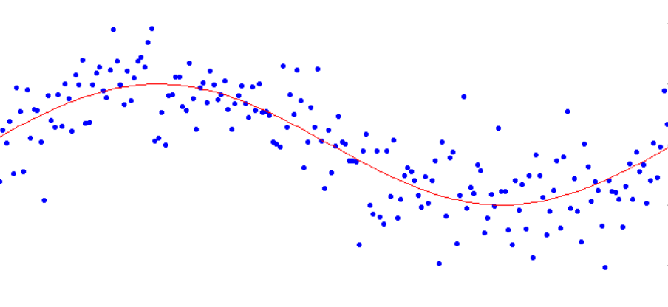
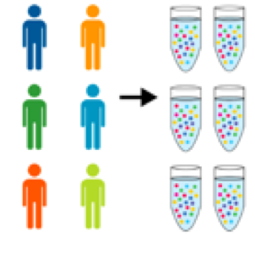
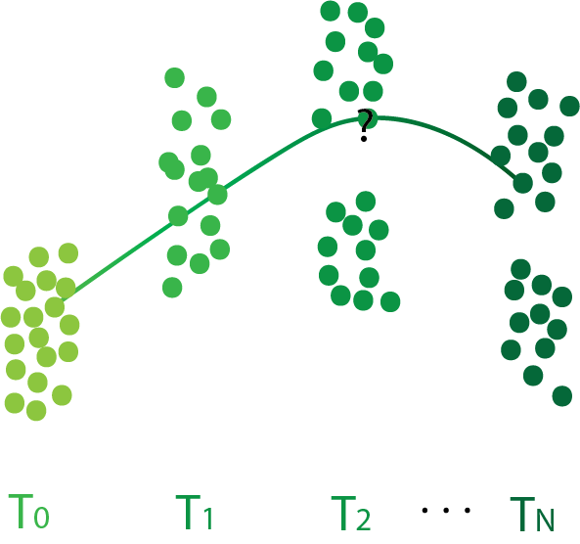
Goals
Denoise Data
Organize multiple samples
Distill the structure
Understand Progression
Notes:
Features of this data is that its high dimensional ---gives us a view of the whole system, high throughput – measurements for thousands even hundreds of thousands of cells in each condition. And single cell resolution.

